Slide 1
CPT113 Assignment Dr. NurulHashimah semester-2
Name: Anjumanara Athina Matric no: 155142

Slide 2
Topics:
1. Question
2. Flowchart
3. ScreenShots of cpp files (main , dynamic_queue.h)
-input and output

Slide 3
1. Question

Slide 4
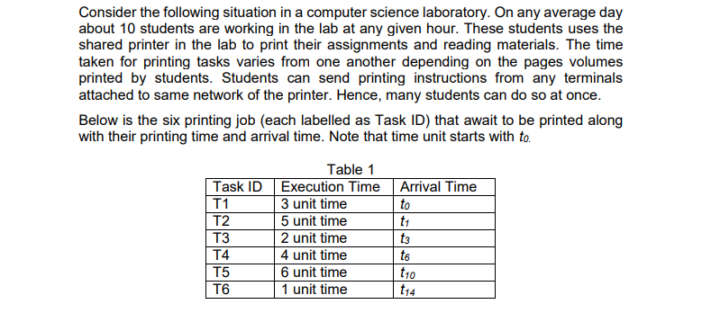

Slide 5
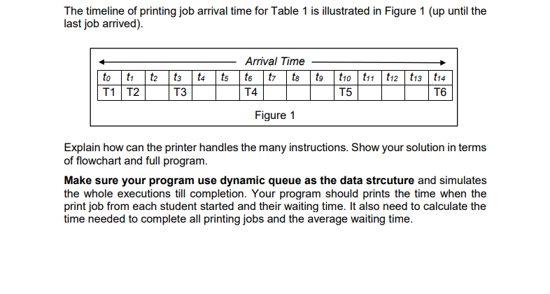

Slide 6
2. Flowchart

Slide 7
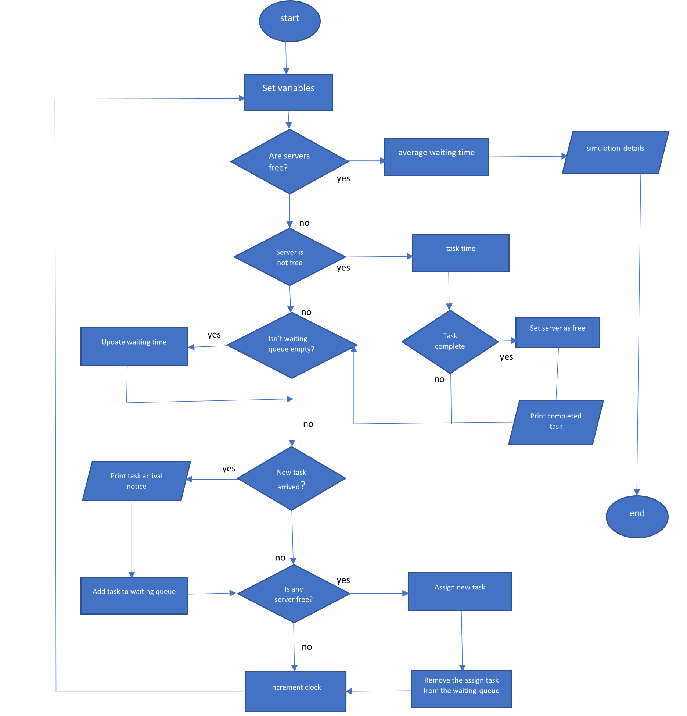

Slide 8
3. ScreenShots of cpp files

Slide 9
Input

Slide 10
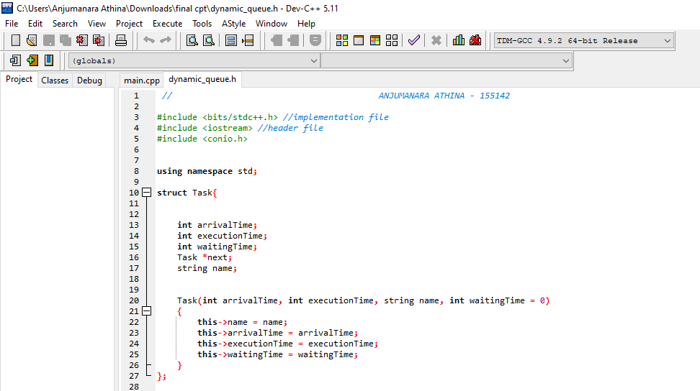

Slide 11
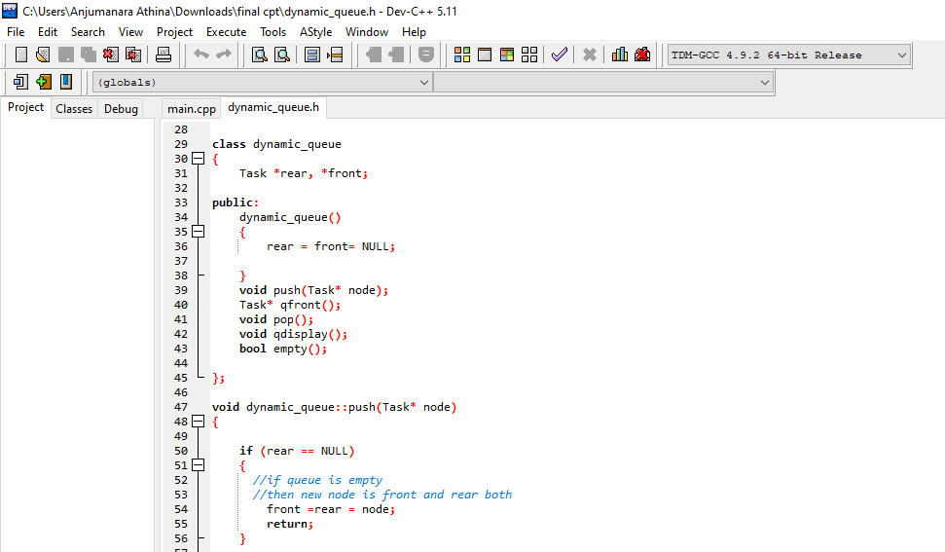

Slide 12
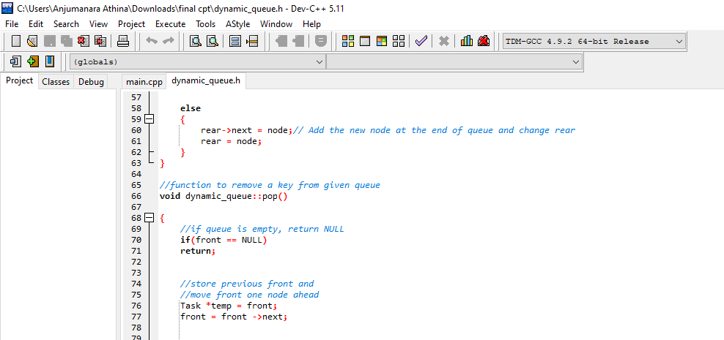

Slide 13
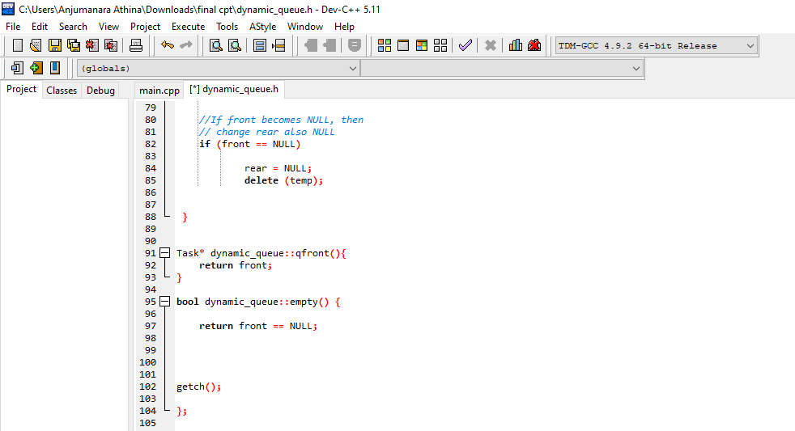

Slide 14
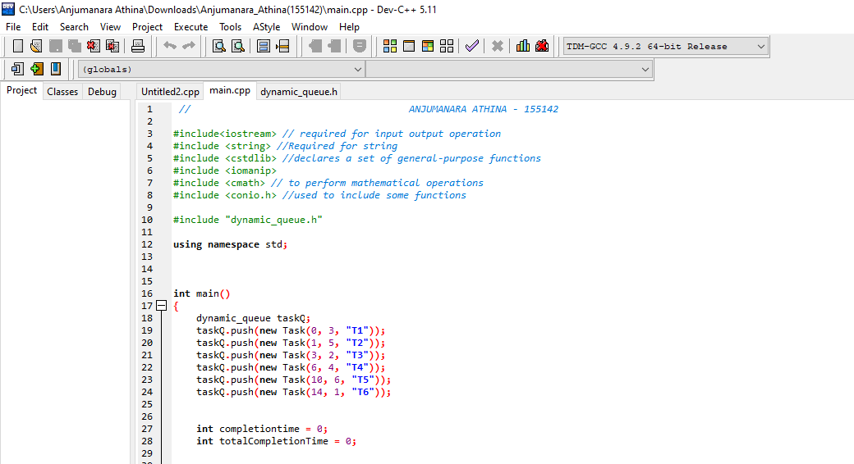

Slide 15
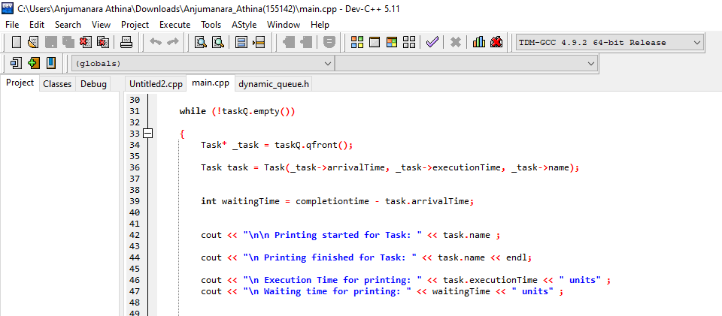

Slide 16
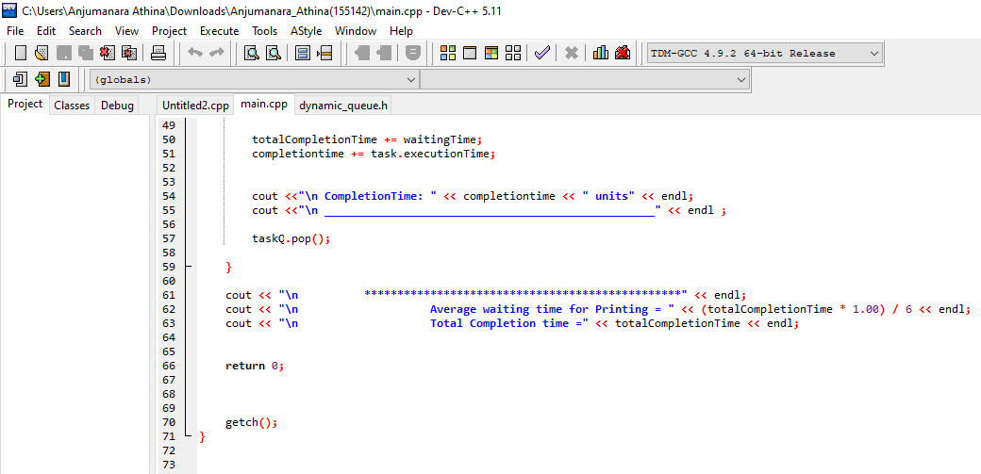

Slide 17
Output

Slide 18
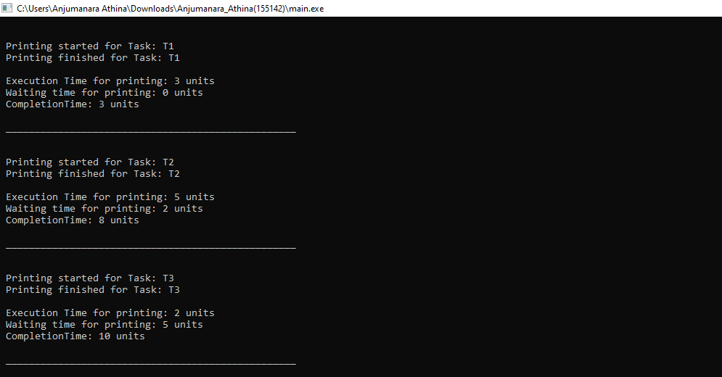

Slide 19
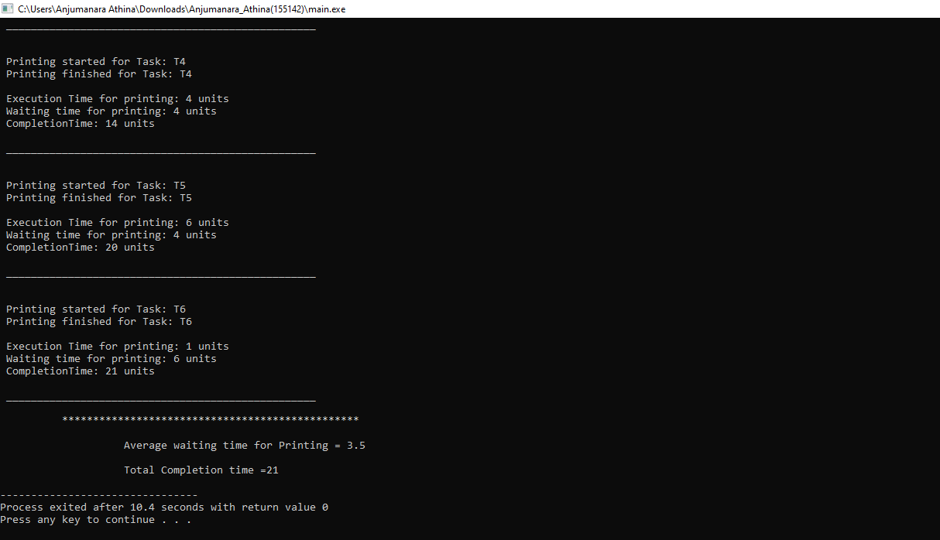

Slide 20
Thank You

